Slide 1
Datacenter Networks
Presented by: Krishangee Bora, Wasfi Momen, and Swapnil Pandey

Slide 2
New Placeholder
20 slides, can go more if possible
10 for review of problem and new problem statement
Review over problem statement in a flow chart diagram
Similar to last presentation but this time include all the variables in a matrix and input them to a solver
Go over the author and what they for implementation
10 for implementing problem statement solution
Our naive solution what things we tried and failed at
Utility function?
What benefits?
What failures/difficulties?

Slide 3
Previous Problem Statement
Scheduling jobs and congestive control with performance isolation and objective scheduling
COMPLETED add a flowchart (can rip from old diagrams)
Input: Matrices representing input and constraints along with objective function
Function: The scheduler
Output: Sorted tasks of decreasing completion time that can be assigned to datacenters.
Our implementation idea was to see if we can add a utility function
Show simple modification of objective function with utility added.
Mention this was hard problem
how to guarantee fairness without killing task completion times?
Instead we actively consider constraints via constraint-breaking methods used in Convex Optimization problems such as barrier method or penalty method.
Which utility function would be best for this?
Scheduling jobs and congestive control with performance isolation and objective scheduling
Our implementation idea was to see if we can add a utility function for scheduling jobs.
This was hard problem
how to guarantee some measure of utility without killing task completion times and fairness?
were there any other tools that could've helped us to solve this problem?

Slide 4
31 24 30 10 14 23
40 12 33
94 89 30 86 53 27 70 90 25
20 10 30 40 100 30
30 20 10
34 50 30
10 23 20
50 20 34
execution time
input data size
link bandwidth
resource capacity
DC 1
Scheduler
𝜏₁ | 𝜏₂ | 𝜏₃ | 𝜏₄
DC 2
max
min
Objective: 𝜏_{k} = max (c + e)
*c is input data size / link bandwidth. e is execution time.
DC 3

Slide 5
Known Research Concepts
Prior class knowledge: https://grid.cs.gsu.edu/cao/Teaching/19SP8220/Contents/L09-QoS.pdf
In QoS, we asked whether a new task could be accepted based on admission control.
This was made via priority classes providing isolation for the flows.
For isolation described in the papers and for our project, we want to "mess up" the other tasks in the solution in order to accommodate this new task, but still keep it within reasonable utility.
This will be made via understanding convex optimization functions that will help in an LP problem model.
TCP as we know it can be used for shorter span of network coverage.
QoS: Quality of Service can be referred to as the technique of managing the data traffic in order to reduce network anomalies such as packet loss, latency jitters etc, which could be accomplished by -
Prioritizing
Resource reservation
And Control mechanisms
The idea of admission control -> when we get a new user do we accept flow or not based on if it will decrease utility.
Can't do that here. We need guarantee that task will be done even with 0 utility. (Flow <= 0 shouldn't be possible since Constraint of x=1 exists)
Instead of admission control, we can look into convex optimization to see if QoS is possible while maintaining its properties of performance isolation and objective scheduling.

Slide 6
Overview of Convex Optimization
Convex Optimization Problems
Overview: https://www.cs.ubc.ca/labs/lci/mlrg/slides/non_convex_optimization.pdf
Other ideas in Convex Optimization
https://en.wikipedia.org/wiki/Penalty_method
https://en.wikipedia.org/wiki/Gradient_descent
https://en.wikipedia.org/wiki/Lagrange_multiplier guarantees a optimal solution somewhere along feasible region.
https://en.wikipedia.org/wiki/Simplex_algorithm
Emphasis should be on the feasible region, the idea of the Dominant Set Problem/Convex Hull for optimal functions, and the idea that all of these concepts can help build a solution that might not pick the only optimal solution but one closests for utility considerations.
We tried different ways of examining our problem and finding useful mathematical tools to provide a solution.
In a guaranteed space where a feasible region exists, these concepts help find ways to the optimal solution.
We tried different ways of examining our problem and finding useful mathematical tools to provide a solution.
Optimization problems are made up of three things: the objective function, inequality constraints, and equality constraints.
Convex optimization gives some guarantees of finding an optimal solution.
But we need to find a region around this optimal solution that still satisfies constraints to a certain degree.
We now look at several topics that we discovered on our way to find a better understanding of the problem...

Slide 7
We looked at gradient descent one of the ways to find an optimal solution.
Gradient Descent is iteratively "stepping" towards the optimal solution.
For example, we can try to find a minimum of a function by taking the derivative of it.
To perform gradient descent,
It wont work out due to the following reasons::-
Gradient descent tries to find the optimal solution, but we're trying to find a space around the optimal such that our constraints are still satisfied.
E.g.
Imagine a circle where the center is the optimal solution. Gradient descent is starting from the edge of the circle and working towards the inner in the form of line segments. You will eventually find the center.
However, we wish to find a suboptimal solution yet binded by our constraints aka a circle within a circle. Gradient Descent does not provide this, but it helped us understand a way of finding a solution for our paper.

Slide 8
We looked at gradient descent one of the ways to find an optimal solution.
Gradient Descent is iteratively "stepping" towards the optimal solution.
For example, we can try to find a minimum of a function by taking the derivative of it.
To perform gradient descent,
It wont work out due to the following reasons::-
Gradient descent tries to find the optimal solution, but we're trying to find a space around the optimal such that our constraints are still satisfied.
E.g.
Imagine a circle where the center is the optimal solution. Gradient descent is starting from the edge of the circle and working towards the inner in the form of line segments. You will eventually find the center.
However, we wish to find a suboptimal solution yet binded by our constraints aka a circle within a circle. Gradient Descent does not provide this, but it helped us understand a way of finding a solution for our paper.

Slide 9
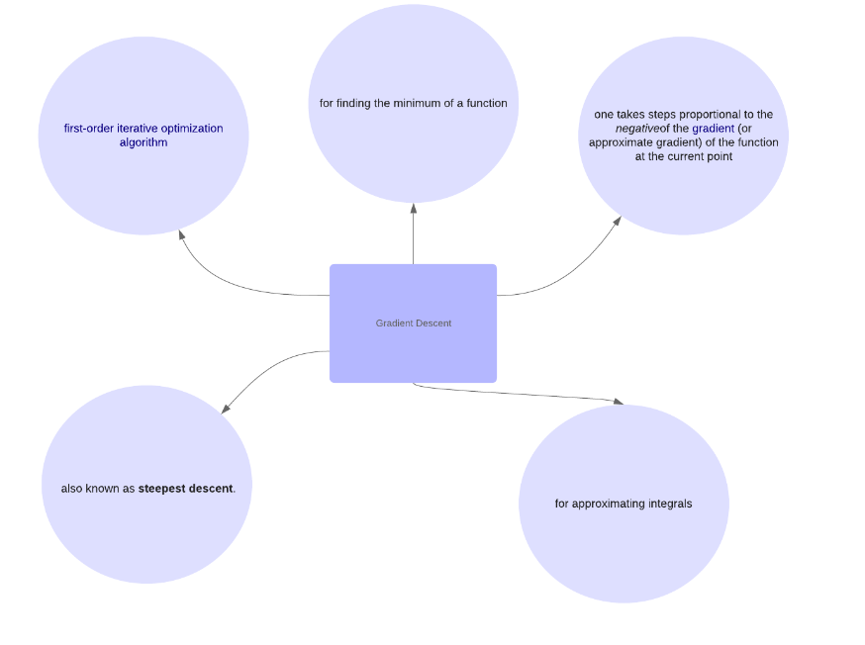
Gradient Descent (Krishangee)
We looked at gradient descent one of the ways to find an optimal solution.
Gradient Descent is iteratively "stepping" towards the optimal solution.
For example, we can try to find a minimum of a function by taking the derivative of it.
To perform gradient descent,
It wont work out due to the following reasons::-
Gradient descent tries to find the optimal solution, but we're trying to find a space around the optimal such that our constraints are still satisfied.
E.g.
Imagine a circle where the center is the optimal solution. Gradient descent is starting from the edge of the circle and working towards the inner in the form of line segments. You will eventually find the center.
However, we wish to find a suboptimal solution yet binded by our constraints aka a circle within a circle. Gradient Descent does not provide this, but it helped us understand a way of finding a solution for our paper.

Slide 10
Penalty Method
Penalty functions allow you to violate constraints within a coefficient.
Barrier method allows you to do it by threshold.
Can scale gracefully with constraints rather than applying it generally to an objective function or its inequality or equality.
Hey @wasfi I can’t find anything good to write about barrier fn also the stuff that i wrote about penalty method , is it enough?
Here the minimum
It’s the simple method of solving constrained optimisation by replacing it with series of unconstrained problems, which could be done by adding an Penalty function.
The goal of penalty functions is to convert constrained problems into unconstrained problems by introducing an artificial penalty for violating the constraint.
min f(x)
min f(x) + σ g*

Slide 11
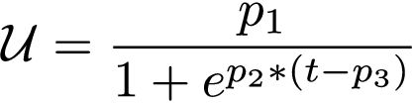

Research Execution
https://tspace.library.utoronto.ca/bitstream/1807/91839/3/Chen_Li_201811_PhD_thesis.pdf page 84
https://web.stanford.edu/~boyd/cvxbook/bv_cvxslides.pdf page 273. Book here at page 568: https://web.stanford.edu/~boyd/cvxbook/bv_cvxbook.pdf
Chen's utility function:
We took a look at this function for giving utility for a time-sensitive (DS) coflow:
p1 as priority parameter, p2 as decay, p3 as desired time for a particular flow sigmoid function to scale utility with.
Barrier method:
Attempts to violate constraints for every variable in a convex objective within a threshold. Threshold is given as m/t. (m as the number of variables to optimize)

Slide 12
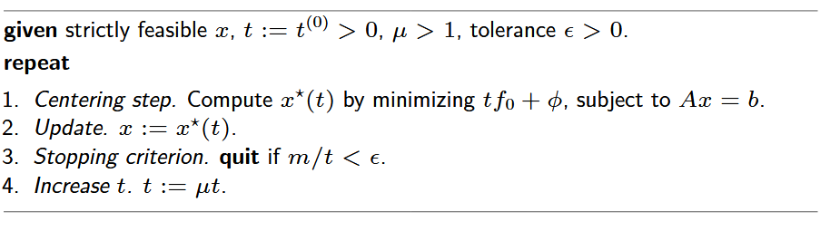
Algorithm representing barrier method.
Centering is Netwon's centering (itself an algoritm) where you update each x optimal solutions with their gradients and doing a line search algorithm.
Update every x with its optimal centered x according to threshold t.
Increase threshold.
If the max threshold is reach, stop the program

Slide 13
Discussion of Implementation
This is what the authors did:
Apache Spark implementation
Fully modeled a LP problem in Apache Spark
Set up multiple Amazon datacenters with their scheduling algorithm
Ran huge data analytics datasets to test
This is what we're doing:
Model a statistical representation of our model in linear programming with python
Current status:
Linear programming model going
Barrier function next to be implemented, finding correct constraints for the data
Finding metrics and a baseline to compare to.
Experimenting with threshold value.

Slide 14
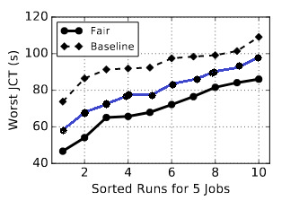
Expected Results
We expect results to be higher than the author's baseline.
Makes sense since we are violating constraints given by the authors' model.
Establishing comparable baseline might result is loss of generality
LP problems are very interesting and represent one of the many approximation fields dedicated to solving hard problems like Dominant Set or Vertex Coverage.
Focus on performance isolation and objective
scheduling only just now coming to research.

Slide 15
Thank You!

